Slide 1
ANTIDEPRESSANT AGENT

Slide 2
COURSE OUTLINE
INTRODUCTION TO DEPRESSION
BRIEF HISTORY OF MAJOR DEPRESSION DISORDERS
USE OF ANTIDEPRESSANT
PATHOPHYSIOLOGY OF MAJOR DEPRESSION
NEUROTROPHIC HYPOTHESIS
MONOAMINES HYPOTHESIS
NEUROENDOCRINE FACTORS IN THE PATHOPHYSIOLOGY OF DEPRESSION
BASIC PHARMACOLOGY OF ANTIDEPRESSANT.

Slide 3
COURSE OUTLINE
PHAMACOKINECTICS OF ANTIDEPRESSANT
PHACODYNAMICS OF ANTIDEPRESSANT
CLINICAL PHARMACOLOGY OF ANTIDEPRESSANT
FACTORS THAT INFLUENCE ANTIDEPRESSANT SELECTION
DOSING
ADVERSE EFFECTS
OVERDOSE
DRUG INTERACTION

Slide 4
COURSE OUTLINE
INTRODUCTION TO DEPRESSION
BRIEF HISTORY OF MAJOR DEPRESSION DISORDERS
USE OF ANTIDEPRESSANT
PATHOPHYSIOLOGY OF MAJOR DEPRESSION
NEUROTROPHIC HYPOTHESIS
MONOAMINES HYPOTHESIS
NEUROENDOCRINE FACTORS IN THE PATHOPHYSIOLOGY OF DEPRESSION
BASIC PHARMACOLOGY OF ANTIDEPRESSANT.

Slide 5
COURSE OUTLINE
PHAMACOKINECTICS OF ANTIDEPRESSANT
PHACODYNAMICS OF ANTIDEPRESSANT
CLINICAL PHARMACOLOGY OF ANTIDEPRESSANT
FACTORS THAT INFLUENCE ANTIDEPRESSANT SELECTION
DOSING
ADVERSE EFFECTS
OVERDOSE
DRUG INTERACTION

Slide 6
INTRODUCTION TO DEPRESSION
Depression is characterized by disturbances in sleep and appetite.
As well as deficits in cognition and energy.
Thoughts of guilt, worthlessness, and suicide are common in depressed people.
The diagnosis of depression still rests primarily on the clinical interview.
Major depressive disorder (MDD) is characterized by depressed mood most of the time for at least 2 weeks and/or loss of interest or pleasure in most activities.

Slide 7
INTRODUCTION TO DEPRESSION
Disease mostly common in depressed people are
Coronary arterydisease,
Diabetes,
Stroke.
Depression may considerably worsen the prognosis for patients with a variety of comorbid medical conditions.

Slide 8
BRIEF HISTORY OF MAJOR DEPRESSION
According to a 2007 report by the Centers for Disease Control and Prevention, antidepressant drugs were the most commonly prescribed medications in the USA at the time of the survey.
MDD represents one of the most common causes of disability in the developed world.
In addition, major depression is commonly associated with a variety of medical conditions,from chronic pain to coronary artery disease.
When depression coexists with other medical conditions, the patient’s disease burden increases, and the quality of life.
And often the prognosis for effective treatment decreases significantly.

Slide 9
USE OF ANTIDEPRESSANT
Antidepressants have received Food and Drug Administration (FDA) approvals for the treatment of panic disorders
Antidepressants are commonly used to treat pain disorders such as neuropathic pain and the pain associated with fibromyalgia.
Antidepressants are used for treating premenstrual dysphoric disorder (PMDD), mitigating the vasomotor symptoms of menopause.
Antidepressants are used for treating stress urinary incontinence.
Their primary use remains the treatment for MDD.

Slide 10
PATHOPHYSIOLOGY OF MAJOR DEPRESSION
A deficit in function or amount of monoamines (the monoamine hypothesis ) is central to the biology of depression
Neurotrophic and endocrine factors play a major role (the neurotrophic hypothesis) .
Histologic studies, structural and functional brain imaging research, genetic findings, and steroid research all suggest a complex pathophysiology for major depression disorder with important implications for drug treatment.

Slide 11
NEUROTROPHIC HYPOTHESIS
There is substantial evidence that nerve growth factors such as brain-derived neurotrophic factor (BDNF) are critical in the regulation of neural plasticity, resilience, and neurogenesis.
The evidence suggests that depression is associated with the loss of neurotrophic support
Effective antidepressant therapies increase neurogenesis and synaptic connectivity in cortical areas such as the hippocampus
BDNF is thought to exert its influence on neuronal survival and growth effects by activating the tyrosine kinase receptor B in both neurons and glia.

Slide 12
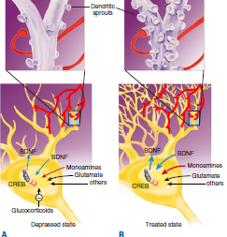

Slide 13
NEUROTROPHIC HYPOTHESIS
Over 30 structural imaging studies suggest that major depression is associated with a 5–10% loss of volume in the hippocampus,although some studies have not replicated this finding.
Depression and chronic stress states have also been associated with a substantial loss of volume in the anterior cingulate and medial orbital frontal cortex.
Loss of volume in structures such as the hippocampus also appears to increase as a function of the duration of illness and the amount of time that the depression remains untreated.

Slide 14
NEUROTROPHIC HYPOTHESIS
Direct infusion of BDNF into the midbrain, hippocampus, and lateral ventricles of rodents has an antidepressant-like effect in animal models.
All known classes of antidepressants are associated with an increase in BDNF levels in animal models with chronic (but not acute) administration.
Mutations in the BDNF gene have been found to be associated with altered anxiety and depressive behavior in both animal and human studies.

Slide 15
MONOAMINES HYPOTHESIS
Monoamines hyposynthesis suggests that depression is related to a deficiency in the amount or function of cortical and limbic serotonin (5-HT), norepinephrine (NE), and dopamine (DA).
Reserpine treatment, which is known to deplete monoamines, is associated with depression in a subset of patients.
Depressed patients who respond to serotonergic antidepressants such as fluoxetine often rapidly suffer relapse when given diets free of tryptophan, a precursor of serotonin synthesis.

Slide 16
MONOAMINES HYPOTHESIS
Patients who respond to noradrenergic antidepressants such as desipramine are less likely to relapse on a tryptophan-free diet.
Depleting catecholamines in depressed patients who have previously responded to noradrenergic agents likewise tends to be associated with relapse.
Administration of an inhibitor of norepinephrine synthesis is also associated with a rapid return of depressive symptoms in patients who respond to noradrenergic
But not necessarily in patients who had responded to serotonergic antidepressants.

Slide 17
MONOAMINES HYPOTHESIS
The monoamine hypothesis also comes from genetic studies.
A functional polymorphism exists for the promoter region of the serotonin transporter gene, which regulates how much of the transporter protein is available.
Subjects who are homozygous for the s(short) allele may be more vulnerable to developing major depression and suicidal behavior in response to stress.
Conversely,subjects with the l (long) allele tend to be more resistant to stress and may be more likely to respond to serotonergic antidepressants

Slide 18
MONOAMINES HYPOTHESIS
A reduction in the primary serotonin metabolite 5-hydroxyindoleacetic acid in the cerebrospinal fluid is associated with violent and impulsive behavior, including violent suicide attempts.

Slide 19
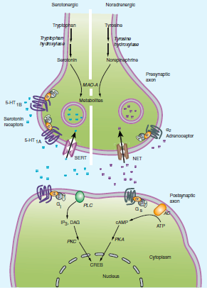
THE AMINE HYPOSYNTHESIS OF MAJOR DEPRESSION

Slide 20
NEUROENDOCRINE FACTORS IN THE PATHOPHYSIOLOGY OF DEPRESSION
Depression is known to be associated with a number of hormonal abnormalities. Among the most replicated of these findings are abnormalities in the HPA axis in patients with MDD
Major depression disorder is associated with elevated cortisol levels , nonsuppression of adrenocorticotropic hormone (ACTH) release in the dexamethasone suppression test, and chronically elevated levels of corticotrophins-releasing hormone.
Thyroid dysregulation has also been reported in depressed patients. Up to 25% of depressed patients are reported to have abnormal thyroid function

Slide 21
NEUROENDOCRINE FACTORS IN THE PATHOPHYSIOLOGY OF DEPRESSION
These include a blunting of response of thyrotropin to thyrotropin-releasing hormone, and elevations in circulating thyroxine during depressed states
Thyroid hormones are also commonly used in conjunction with standard antidepressants to augment therapeutic effects of the latter.
sex steroids are also implicated in the pathophysiology of depression
Estrogen deficiency states, which occur in the postpartum and postmenopausal periods, are thought to play a role in the etiology of depression in some women.
Severe testosterone deficiency in men is sometimes associated with depressive symptoms

Slide 22
BASIC PHARMACOLOGY OF ANTIDEPRESSANTS
SELECTIVE SEROTONIN REUPTAKE INHIBITORS
The selective serotonin reuptake inhibitors (SSRIs) represent a chemically diverse class of agents that have as their primary action the inhibition of the serotonin transporter (SERT)
There are currently six available SSRIs, and they are the most common antidepressants in clinical use.
In addition to their use in major depression, SSRIs have indications in GAD, PTSD, OCD, panic disorder, PMDD, and bulimia.
Fluoxetine, sertraline, and citalopram exist as isomers and are formulated in the racemic forms.

Slide 23
BASIC PHARMACOLOGY OF ANTIDEPRESSANTS
Escitalopram is the S enantiomer of citalopram. As with all antidepressants, SSRIs are highly lipophilic.
The development of fluoxetine emerged out of the search for chemicals that had high affinity for monoamine receptors but lacked the affinity for histamine, acetylcholine, and α adrenoceptors that is seen with the tricyclic antidepressants (TCAs).
The popularity of SSRIs stems largely from their ease of use, safety in overdose, relative tolerability, cost (all except escitalopram are generically available), and broad spectrum of use

Slide 24
BASIC PHARMACOLOGY OF ANTIDEPRESSANTS
SEROTONIN-NOREPINEPHRINE REUPTAKE INHIBITORS
Two classes of antidepressants act as combined serotonin and norepinephrine reuptake inhibitors which are Selective serotonin norepinephrine reuptake inhibitors (SNRIs) and TCAs.
SELECTIVE SEROTONIN-NOREPINEPHRINE REUPTAKE INHIBITORS
The SNRIs include venlafaxine, its metabolite desvenlafaxine, and duloxetine.
Another SNRI, milnacipran, has been approved for the treatment of fibromyalgia in the USA but has been studied extensively as an antidepressant.
SNRIs are also used in the treatment of generalized anxiety, stress urinary incontinence, and vasomotor symptoms of menopause.

Slide 25
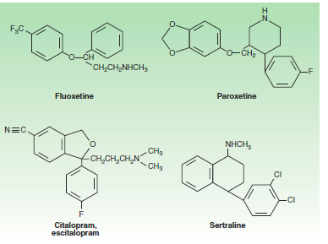

Slide 26
BASIC PHARMACOLOGY OF ANTIDEPRESSANTS
SNRIs are chemically unrelated to each other.
Venlafaxine was discovered in the process of evaluating chemicals that inhibit binding of imipramine.
Venlafaxine’s in vivo effects are similar to those of imipramine but with a more favorable adverse-effect profile.
All SNRIs bind the serotonin (SERT) and norepinephrine (NET) transporters, as do the TCAs.
However, unlike the TCAs, the SNRIs do not have much affinity for other receptors.

Slide 27
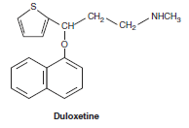
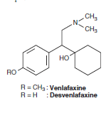

Slide 28
BASIC PHARMACOLOGY OF ANTIDEPRESSANTS
Venlafaxine and desvenlafaxine are bicyclic compounds, Whereas duloxetine is a three-ring structure unrelated to the TCAs.
Milnacipran contains a cyclopropane ring and is provided as a racemic mixture.
TRICYCLIC ANTIDEPRESSANT
The TCAs were the dominant class of antidepressants until the introduction of SSRIs in the 1980s and 1990s.
Nine TCAs are available in the USA, and they all have an iminodibenzyl (tricyclic) core .
The chemical differences between the TCAs are relatively subtle.

Slide 29
BASIC PHARMACOLOGY OF ANTIDEPRESSANTS
For example, the prototype TCA imipramine and its metabolite, desipramine, differ by only a methyl group in the propylamine side chain.
However, this minor difference results in a substantial change in their pharmacologic profiles.
Imipramine is highly anticholinergic and is a relatively strong serotonin as well as norepinephrine reuptake inhibitor.
In contrast, desipramine is much less anticholinergic and is a more potent and somewhat more selective norepinephrine reuptake inhibitor than is imipramine.
TCAs are used primarily in depression that is unresponsive to more commonly used antidepressants such as the SSRIs or SNRIs.
Other uses for TCAs include the treatment of pain conditions, enuresis, and insomnia

Slide 30
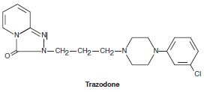
BASIC PHARMACOLOGY OF ANTIDEPRESSANTS
5-HT 2 ANTAGONISTS
Two antidepressants are thought to act primarily as antagonists at the 5-HT 2 receptor: trazodone and nefazodone.
Trazodone’s structure includes a triazolo moiety that is thought to impart antidepressant effects.
Its primary metabolite, m-chlorphenylpiperazine (m-cpp), is a potent 5-HT 2 antagonist

Slide 31
BASIC PHARMACOLOGY OF ANTIDEPRESSANTS
The most common use of trazodone in current practice is as an unlabeled hypnotic, since it is highly sedating and not associated with tolerance or dependence
Nefazodone is chemically related to trazodone
Its primary metabolites, m-cpp and hydroxynefazodone are both inhibitors of
the 5-HT 2 receptor
Though still available generically, nefazodone is no longer commonly prescribed.
The primary indication for both nefazodone and trazodone are major depression
Although both have also been used in the treatment of anxiety

Slide 32

BASIC PHARMACOLOGY OF ANTIDEPRESSANTS

Slide 33
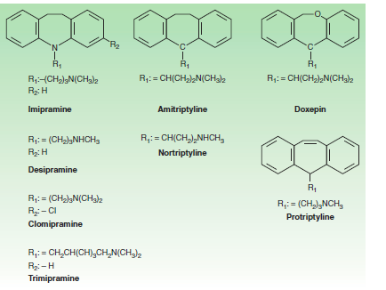
STRUCTURES OF TRICYCLIC ANTIDEPRESSANT

Slide 34
BASIC PHARMACOLOGY OF ANTIDEPRESSANTS
TETRACYCLIC AND UNICYCLIC ANTIDEPRESSANTS
A number of antidepressants do not fit neatly into the other classes.
Among these are bupropion, mirtazapine, amoxapine, and
maprotiline
BUPROPION
Bupropion has a unicyclic aminoketone structure.
Its unique structure results in a different side-effect profile than most antidepressants.
Bupropion somewhat resembles amphetamine in chemical structure and, like the stimulant, has central nervous system (CNS) activating properties.

Slide 35
BASIC PHARMACOLOGY OF ANTIDEPRESSANTS
MIRTAZAPINE
Mirtazapine is one of the few antidepressants not commonly associated with sexual side effects.
It has a tetracyclic chemical structure and belongs to the piperazino-azepine group of compounds.
Mirtazapine, amoxapine, and maprotiline have tetracyclic structures.
Amoxapine is the N -methylated metabolite of loxapine,an older antipsychotic drug

Slide 36
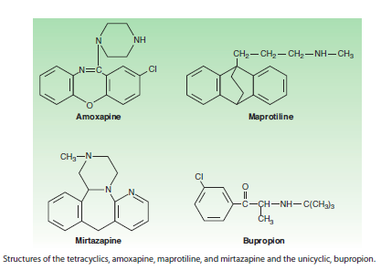

Slide 37
BASIC PHARMACOLOGY OF ANTIDEPRESSANTS
Amoxapine and maprotiline share structural similarities and side effects comparable to the TCAs.
As a result, these tetracyclics are not commonly prescribed in current practice.
MONOAMINE OXIDASE INHIBITORS
Monoamine oxidase inhibitors (MAOIs) are arguably the first modern class of antidepressants
(MAOIs) were introduced in the 1950s but are now rarely used in clinical practice because of toxicity and potentially lethal food and drug interactions

Slide 38
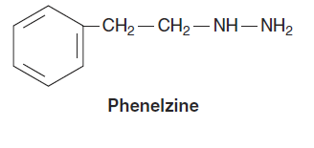
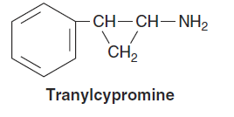

Slide 39
BASIC PHARMACOLOGY OF ANTIDEPRESSANTS
Current MAOIs include
The Hydrazine derivatives phenelzine and isocarboxazid and
The Non-hydrazines tranylcypromine, selegiline, and moclobemide
The hydrazines and tranylcypromine bind irreversibly and nonselectively with MAO-A and –B
Other MAOIs may have more selective or reversible properties such as tranylcypromine resemble amphetamine in chemical structure
Other MAOIs such as selegiline have amphetamine-like metabolites.
As a result, these MAOIs tend to have substantial CNS-stimulating effects

Slide 40
BASIC PHARMACOLOGY OF ANTIDEPRESSANTS
Their primary use now is in the treatment of depression unresponsive to other antidepressants.
However, MAOIs have also been used historically to treat anxiety states, including social anxiety and panic disorder.
In addition , selegiline is used for the treatment of Parkinson’s disease .

Slide 41
PHARMACOKINECTICS
The antidepressants share several pharmacokinetic features
Most have fairly rapid oral absorption
Achieve peak plasma levels within 2–3 hours
Are tightly bound to plasma proteins
Undergo hepatic metabolism
Renally cleared.
However, even within classes, the pharmacokinetics of individual antidepressants varies considerably.

Slide 42
PHARMACOKINECTICS
SELECTIVE SEROTONIN REUPTAKE INHIBITOR
The prototype SSRI, fluoxetine, differs from other SSRIs in some important aspects .
Fluoxetine is metabolized to an active product, norfluoxetine, which may have plasma concentrations greater than those of fluoxetine.
The elimination half-life of norfluoxetine is about three times longer than fluoxetine and contributes to the longest half-life of all the SSRIs.
As a result, fluoxetine has to be discontinued 4 weeks or longer before an MAOI can be administered to mitigate the risk of serotonin syndrome.

Slide 43
PHARMACOKINECTICS
Fluoxetine and paroxetine are potent inhibitors of the CYP2D6 isoenzyme, and this contributes to potential drug interactions .
In contrast, fluvoxamine is an inhibitor of CYP3A4, whereas
citalopram, escitalopram, and sertraline have more modest CYP interactions.

Slide 44
PHARMACOKINECTICS
SEROTONIN-NOREPINEPHRINE REUPTAKE INHIBITORS
SELECTIVE SEROTONIN-NOREPINEPHRINE REUPTAKE INHIBITORS
Venlafaxine is extensively metabolized in the liver via the CYP2D6 isoenzyme to O -desmethylvenlafaxine (desvenlafaxine).
Both have similar half-lives of about 11 hours.
Despite the relatively short half-lives, both drugs are available in formulations that allow once-daily dosing.
Venlafaxine and desvenlafaxine have the lowest protein binding of all antidepressants (27–30%).

Slide 45
PHARMACOKINECTICS
Unlike most antidepressants, desvenlafaxine is conjugated and does not undergo extensive oxidative metabolism.
At least 45% of desvenlafaxine is excreted unchanged in the urine compared with 4–8% of venlafaxine.
Duloxetine is well absorbed and has a half-life of about 12 hours but is dosed once daily.
It is tightly bound to protein (97%) and undergoes extensive oxidative metabolism via CYP2D6 and CYP1A2.
Hepatic impairment significantly alters duloxetine levels unlike desvenlafaxine.

Slide 46
PHARMACOKINECTICS
TRICYCLIC ANTIDEPRESSANTS
The TCAs tend to be well absorbed and have long half-lives .
As a result, most are dosed once daily at night because of their sedating effects.
TCAs undergo extensive metabolism via demethylation, aromatic hydroxylation, and glucuronide conjugation.
Only about 5% of TCAs are excreted unchanged in the urine.
The TCAs are substrates of the CYP2D6 system, and the serum levels of these agents tend to be substantially influenced by concurrent administration of drugs such as fluoxetine.

Slide 47
PHARMACOKINECTICS
In addition, genetic polymorphism for CYP2D6 may result in low or extensive metabolism of the TCAs.
The secondary amine TCAs, including desipramine and nortriptyline,lack active metabolites and have fairly linear kinetics.
These TCAs have a wide therapeutic window, and serum levels are reliable in predicting response and toxicity.
5-HT 2 ANTAGONISTS
Trazodone and nefazodone are rapidly absorbed and undergo extensive hepatic metabolism

Slide 48
PHARMACOKINECTICS
Trazodone and nefazodone are rapidly absorbed and undergo extensive hepatic metabolism.
Both drugs are extensively bound to protein and have limited bioavailability because of extensive metabolism.
Their short half-lives generally require split dosing when used as antidepressants.
However, trazodone is often prescribed as a single dose at night as a hypnotic in lower doses than are used in the treatment of depression.

Slide 49
PHARMACOKINECTICS
Both trazodone and nefazodone have active metabolites that also exhibit 5-HT 2 antagonism.
Nefazodone is a potent inhibitor of the CYP3A4 system and may interact with drugs metabolized by this enzyme
TETRACYCLIC AND UNICYCLIC AGENTS
BUPROPION
Bupropion is rapidly absorbed and has a mean protein binding of 85%.
It undergoes extensive hepatic metabolism and has a substantial first-pass effect.
It has three active metabolites including hydroxybupropion; the latter is being developed as an antidepressant

Slide 50
PHARMACOKINECTICS
Bupropion has a biphasic elimination with the first phase lasting about 1 hour
The second phase lasting 14 hours.
AMOXAPINE
Amoxapine is also rapidly absorbed with protein binding of about 85%.
The half-life is variable, and the drug is often given in divided doses.
Amoxapine undergoes extensive hepatic metabolism.
One of the active metabolites, 7-hydroxyamoxapine, is a potent D 2 blocker and is associated with antipsychotic effects.
MAPROTILINE
Maprotiline is similarly well absorbed orally and 88% bound to protein.
It undergoes extensive hepatic metabolism.

Slide 51
PHARMACOKINECTICS
MIRTAZAPINE
Mirtazapine is demethylated followed by hydroxylation and glucuronide conjugation.
Several CYP isozymes are involved in the metabolism of mirtazapine, including 2D6, 3A4, and 1A2.
The half-life of mirtazapine is 20–40 hours, and
it is usually dosed once in the evening because of its sedating effects.

Slide 52
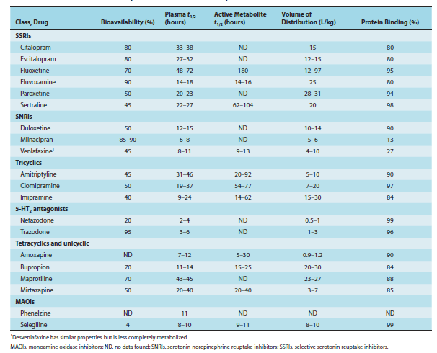
PHARMACOKINETIC PROFILES OF SELECTED ANTIDEPRESSANTS

Slide 53
PHARMACOKINECTICS
MONOAMINE OXIDASE INHIBITORS
The different MAOIs are metabolized via different pathways but tend to have extensive first-pass effects that may substantially decrease bioavailability.
Tranylcypromine is ring hydroxylated and N –acetylated
Whereas acetylation appears to be a minor pathway for phenelzine.
Selegiline is N -demethylated and then hydroxylated.
The MAOIs are well absorbed from the gastrointestinal tract because of the prominent first-pass effects and their tendency to inhibit MAO in the gut (resulting in tyramine pressor effects),

Slide 54
PHARMACOKINECTICS
Alternative routes of administration are being developed.
For example, selegiline is available in both transdermal and sublingual forms that bypass both gut and liver.
These routes decrease the risk of food interactions and provide substantially increased bioavailability.

Slide 55
PHARMACODYNAMICS
As previously noted, all currently available antidepressants enhance monoamine neurotransmission by one of several mechanisms.
The most common mechanism is inhibition of the activity of SERT, NET, or both monoamine transporters
Mechanism for increasing the availability of monoamines is inhibition of their enzymatic degradation (the MAOIs).
Additional strategies for enhancing monoamine tone include binding presynaptic autoreceptors (mirtazapine) or specific postsynaptic receptors (5-HT 2 antagonists and mirtazapine).

Slide 56
PHARMACODYNAMICS
Ultimately, the increased availability of monoamines for binding in the synaptic cleft results in a cascade of events that enhance the transcription of some proteins and the inhibition of others.
It is the net production of these proteins, including BDNF, glucocorticoid receptors,
β adrenoceptors, and other proteins, that appears to determine the benefits as well as the toxicity of a given agent.

Slide 57
PHARMACODYNAMICS
SELECTIVE SEROTONIN REUPTAKE INHIBITORS
The serotonin transporter (SERT) is a glycoprotein with 12 transmembrane regions embedded in the axon terminal and cell body membranes of serotonergic neurons.
When extracellular serotonin binds to receptors on the transporter, conformational changes occur in the transporter and serotonin, Na + , and Cl – are moved into the cell. Binding of intracellular K + then results in return of the transporter to its original conformation and the release of serotonin inside the cell.
SSRIs allosterically inhibit the transporter by binding the receptor at a site other than active binding site for serotonin.
At therapeutic doses, about 80% of the activity of the transporter is inhibited.
Functional polymorphisms exist for SERT that determine the activity of the transporter.
SSRIs have modest effects on other neurotransmitters.

Slide 58
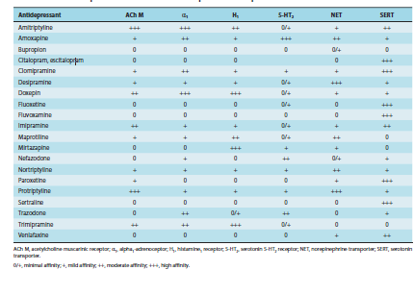
ANTIDEPRESSANT EFFECTS ON SEVERAL RECEPTORS AND TRANSPORTERS.

Slide 59
PHARMACODYNAMICS
Unlike TCAs and SNRIs, there is little evidence that SSRIs have prominent effects on β adrenoceptors or the norepinephrine transporter, NET.
Binding to the serotonin transporter is associated with tonic inhibition of the dopamine system
Although there is substantial interindividual variability in this effect,the SSRIs do not bind aggressively to histamine, muscarinic, or other receptors.

Slide 60
PHARMACODYNAMICS
DRUGS THAT BLOCK BOTH SEROTONIN AND NOREPINEPHRINE TRANSPORTERS
A large number of antidepressants have mixed inhibitory effects on both serotonin and norepinephrine transporters.
The newer agents in this class (venlafaxine and duloxetine) are denoted by the acronym SNRIs, whereas the agents in the older group are termed TCAs.
SEROTONIN-NOREPINEPHRINE REUPTAKE INHIBITORS
SNRIs bind both the serotonin and the norepinephrine transporters

Slide 61
PHARMACODYNAMICS
The NET is structurally very similar to the 5-HT transporter,like the serotonin transporter
It is a 12-transmembrane domain complex that allosterically binds norepinephrine.
The NET also has a moderate affinity for dopamine.
Venlafaxine is a weak inhibitor of NET, whereas desvenlafaxine,duloxetine, and milnacipran are more balanced inhibitors of both SERT and NET.
Nonetheless, the affinity of most SNRIs tends to be much greater for SERT than for NET.

Slide 62
PHARMACODYNAMICS
The SNRIs differ from the TCAs in that they lack the potent antihistamine, α-adrenergic blocking, and anticholinergic effects of the TCAs.
As a result, the SNRIs tend to be favored over the TCAs in the treatment of MDD and pain syndromes because of their better tolerability.
TRICYCLIC ANTIDEPRESSANTS
Within the TCAs, there is considerable variability in affinity for SERT versus NET.
For example, clomipramine has relatively very little affinity for NET but potently binds SERT

Slide 63
PHARMACODYNAMICS
This selectivity for the serotonin transporter contributes to clomipramine’s known benefits in the treatment of OCD.
On the other hand, the secondary amine TCAs, desipramine and nortriptyline, are relatively more selective for NET.
Although the tertiary amine TCA imipramine has more serotonin effects initially, its metabolite, desipramine, then balances this effect with more NET inhibition.

Slide 64
PHARMACODYNAMICS
Common adverse effects of the TCAs, including dry mouth and constipation, are attributable to the potent antimuscarinic effects of many of these drugs.
The TCAs also tend to be potent antagonists of the histamine H 1 receptor.
TCAs such as doxepin are sometimes prescribed as hypnotics and used in treatments for pruritus because of their antihistamine properties.
The blockade of α adrenoceptors can result in substantial orthostatic hypotension,particularly in older patients

Slide 65
PHARMACODYNAMICS
5-HT 2 ANTAGONISTS
The principle action of both nefazodone and trazodone appears to be blockade of the 5-HT 2A receptor.
Inhibition of this receptor in both animal and human studies is associated with substantial antianxiety, antipsychotic, and antidepressant effects.
Conversely,agonists of the 5-HT 2A receptor, eg, lysergic acid (LSD) and mescaline, are often hallucinogenic and anxiogenic.
The 5-HT 2A receptor is a G protein-coupled receptor and is distributed throughout the neocortex.

Slide 66
PHARMACODYNAMICS
Nefazodone is a weak inhibitor of both SERT and NET but is a potent antagonist of the postsynaptic 5-HT 2A receptor, as are its metabolites.
Trazodone is also a weak but selective inhibitor of SERT with little effect on NET.
Its primary metabolite, m-cpp, is a potent 5-HT 2 antagonist, and much of trazodone’s benefits as an antidepressant might be attributed to this effect.
Trazodone also has weak-to-moderate presynaptic α-adrenergic–blocking properties and is a modest antagonist of the H 1 receptor

Slide 67
PHARMACODYNAMICS
Bupropion and its major metabolite hydroxybupropion are modest-to-moderate inhibitors of norepinephrine and dopamine reuptake in animal studies
A more significant effect of bupropion is presynaptic release of catecholamines
Bupropion appears to substantially increase the presynaptic availability of norepinephrine, and dopamine to a lesser extent.
Bupropion has virtually no direct effects on the serotonin system.

Slide 68
PHARMACODYNAMICS
Mirtazapine has a complex pharmacology.
It is an antagonist of the presynaptic α 2 autoreceptor and enhances the release of both norepinephrine and 5-HT.
In addition, mirtazapine is an antagonist of 5-HT 2 and 5-HT 3 receptors.
Finally, mirtazapine is a potent H 1 antagonist, which is associated with the drug’s sedative effects.
The actions of amoxapine and maprotiline resemble those of TCAs such as desipramine.
Both are potent NET inhibitors and less potent SERT inhibitors.

Slide 69
PHARMACODYNAMICS
Both are potent NET inhibitors and less potent SERT inhibitors.
In addition, both possess anticholinergic properties.
Unlike the TCAs or other antidepressants, amoxapine is a moderate inhibitor of the postsynaptic D 2 receptor.
As such, amoxapine possesses some antipsychotic properties.
MONOAMINE OXIDASE INHIBITORS
MAOIs act by mitigating the actions of monoamine oxidase in the neuron and increasing monoamine content
There are two forms of monoamine oxidase

Slide 70
PHARMACODYNAMICS
MAOIs are classified by their specificity for MAO-A or -B and whether their effects are reversible or irreversible.
MAO-A
MAO-A is present in both dopamine and norepinephrine neurons
It is found primarily in the brain, gut,placenta, and liver
its primary substrates are norepinephrine, epinephrine, and serotonin
MAO-B
MAO-B is found primarily in serotonergic and histaminergic neurons
It is distributed in the brain,liver, and platelets

Slide 71
PHARMACODYNAMICS
MAO-B acts primarily on tyramine, phenylethylamine,and benzylamine
Both MAO-A and -B metabolize tryptamine and dopamine.
Phenelzine and tranylcypromine are examples of irreversible, nonselective MAOIs.
Moclobemide can be displaced from MAO-A by tyramine, and this mitigates the risk of food interactions.
In contrast, selegiline is an irreversible MAO-B–specific agent at low doses.
Selegiline is useful in the treatment of Parkinson’s disease at these low doses, but at higher doses it becomes a nonselective MAOI similar to other agents.

Slide 72
CLINICAL PHARMACOLOGY OF ANTIDEPRESSANTS
CLINICAL INDICATION:
DEPRESSION
It is not clear whether antidepressants are useful for all subtypes of depression.
For example, patients with bipolar depression may not benefit much from antidepressants even when added to mood stabilizers.
In fact, the antidepressants are sometimes associated with switches into mania or more rapid cycling.
Psychotherapeutic interventions such as cognitive behavior therapy appear to be as effective as antidepressant treatment for mild to moderate forms of depression

Slide 73
CLINICAL PHARMACOLOGY OF ANTIDEPRESSANTS
However, cognitive behavior therapy tends to take longer to be effective and is generally more expensive than antidepressant treatment
Psychotherapy is often combined with antidepressant treatment, and the combination appears more effective than either strategy alone.
ANXIETY DISORDER
After major depression, anxiety disorders represent the most common application of antidepressants.
Panic disorder is characterized by recurrent episodes of brief overwhelming anxiety, which often occur without precipitant.
Patients may begin to fear having an attack, or they avoid situations in which they might have an attack.

Slide 74
CLINICAL PHARMACOLOGY OF ANTIDEPRESSANTS
A number of SSRIs and SNRIs have been approved for all the major anxiety disorders,including PTSD, OCD, social anxiety disorder, GAD, and panic disorder.
In contrast, GAD is characterized by a chronic, free-floating anxiety and undue worry that tends to be chronic in nature.
Although older antidepressants and drugs of the sedative-hypnotic class are still occasionally used for the treatment of anxiety disorders,SSRIs and SNRIs have largely replaced them.
The benzodiazepines provide much more rapid relief of both generalized anxiety and panic than do any of the antidepressants.

Slide 75
CLINICAL PHARMACOLOGY OF ANTIDEPRESSANTS
The antidepressants appear to be at least as effective and perhaps more effective than benzodiazepines in the long-term treatment of these anxiety disorders.
Antidepressants do not carry the risks of dependence and tolerance that may occur with the benzodiazepines.
OCD is known to respond to serotonergic antidepressants. It is characterized by repetitive anxiety-provoking thoughts (obsessions) or repetitive behaviors aimed at reducing anxiety .
Clomipramine and several of the SSRIs are approved for the treatment of OCD, and they are moderately effective

Slide 76
CLINICAL PHARMACOLOGY OF ANTIDEPRESSANTS
Behavior therapy is usually combined with the antidepressant for additional benefits
SOCIAL ANXIETY
Social anxiety disorder is an uncommonly diagnosed but a fairly common condition in which the patient experiences severe anxiety in social interactions.
This anxiety may limit their ability to function adequately in their jobs or interpersonal relationships.
Several SSRIs and venlafaxine are approved for the treatment of social anxiety.
The efficacy of the SSRIs in the treatment of social anxiety is greater in some studies than their efficacy in the treatment of MDD.

Slide 77
CLINICAL PHARMACOLOGY OF ANTIDEPRESSANTS
PTSD
PTSD is manifested when a traumatic or life-threatening event results in intrusive anxiety-provoking thoughts or imagery, hypervigilance, nightmares, and avoidance of situations that remind the patient of the trauma.
SSRIs are considered first-line treatment for PTSD and can benefit a number of symptoms including anxious thoughts and hypervigilance.
Other treatments, including psychotherapeutic interventions, are usually required in addition to antidepressants.

Slide 78
CLINICAL PHARMACOLOGY OF ANTIDEPRESSANTS
PAIN DISORDERS
It has been known for over 40 years that antidepressants possess analgesic properties independent of their mood effects.
TCAs have been used in the treatment of neuropathic and other pain conditions since the 1960s.
Medications that possess both norepinephrine and 5-HT reuptake blocking properties are often useful in treating pain disorders.
Ascending corticospinal monoamine pathways appear to be important in the endogenous analgesic system.
Also, chronic pain conditions are commonly associated with major depression.

Slide 79
CLINICAL PHARMACOLOGY OF ANTIDEPRESSANTS
In 2010, duloxetine was approved for the treatment
of chronic joint and muscle pain.
Milnacipran has been approved for the treatment of fibromyalgia.
Other SNRIs e.g desvenlafaxine, are being investigated for a variety of pain conditions from postherpetic neuralgia to chronic back pain.
PREMENSTRUAL DYSPHORIC DISORDER
Approximately 5% of women in the child-bearing years will have prominent mood and physical symptoms during the late luteal phase of almost every cycle; these may include anxiety, depressed mood,, and a variety of other physical symptoms.

Slide 80
CLINICAL PHARMACOLOGY OF ANTIDEPRESSANTS
These symptoms are more severe than those typically seen in premenstrual syndrome (PMS).
The SSRIs are known to be beneficial to many women with PMDD, and fluoxetine and sertraline have been approved for this indication.
The rapid effects of SSRIs in PMDD may be associated with rapid increases in pregnenolone levels.
SMOKING CESSATION
Approximately twice as many people treated with bupropion as with placebo have a reduced urge to smoke
Bupropion appears to be about as effective as nicotine patches in smoking cessation

Slide 81
CLINICAL PHARMACOLOGY OF ANTIDEPRESSANTS
In addition ,patients taking bupropion appear to experience fewer mood symptoms and possibly less weight gain while withdrawing from nicotine dependence.
The mechanism by which bupropion is helpful in this application is unknown, but the drug may mimic nicotine’s effects on dopamine and norepinephrine and may antagonize nicotinic receptors.
Nicotine is also known to have antidepressant effects in some people, and bupropion may substitute for this effect.
Nortriptyline has been shown to be helpful in smoking cessation, but the effects have not been as consistent as those seen with bupropion.

Slide 82
CLINICAL PHARMACOLOGY OF ANTIDEPRESSANTS
EATING DISORDERS
Bulimia nervosa and anorexia nervosa are potentially devastating disorders.
Bulimia is characterized by episodic intake of large amounts of food (binges) followed by ritualistic purging through emesis, the use of laxatives, or other methods.
Medical complications of the purging, such as hypokalemia, are common and dangerous.
Anorexia is often chronic and may be fatal in 10% or more of cases.

Slide 83
CLINICAL PHARMACOLOGY OF ANTIDEPRESSANTS
Anorexia is a disorder in which reduced food intake results in a loss of weight of 15% or more of ideal body weight.
The person has a morbid fear of gaining weight and a highly distorted body image.
Antidepressants appear to be helpful in the treatment of bulimia but not anorexia.
Fluoxetine was approved for the treatment of bulimia in 1996.
Bupropion may have some benefits in treating obesity.
The primary treatment for anorexia at this time is refeeding, family therapy, and cognitive behavioral therapy

Slide 84
CLINICAL PHARMACOLOGY OF ANTIDEPRESSANTS
OTHER USES FOR ANTIDEPRESSANTS
Many of the serotonergic antidepressants appear to be helpful for treating vasomotor symptoms in perimenopause
SSRIs are sometimes used to treat premature ejaculation.

Slide 85
FACTORS TO CONSIDER IN CHOOSING AN ANTIDEPRESSANT
The choice of an antidepressant depends first on the indication.
Not all conditions are equally responsive to all antidepressants.
However, in the treatment of MDD, it is difficult to demonstrate that one antidepressant is consistently more effective than another.
The choice of an antidepressant for the treatment of depression
rests primarily on practical considerations such as
Cost
Availability
Adverse effects
Potential drug interactions
The patient’s history of response or lack thereof, and patient preference

Slide 86
FACTORS TO CONSIDER IN CHOOSING AN ANTIDEPRESSANT
Other factors such as the
Patient’s age:
For example, older patients are particularly sensitive to the anticholinergic effects of the TCAs.
On the other hand, the CYP3A4-inhibiting effects of the SSRI fluvoxamine may make this a problematic choice in some older patients
Because fluvoxamine may interact with many other medications that an older patient may require.

Slide 87
FACTORS TO CONSIDER IN CHOOSING AN ANTIDEPRESSANT
GENDER
There is some suggestion that female patients may respond to and tolerate serotonergic better than noradrenergic or TCA antidepressants
The data supporting this gender difference have not been consistent.
MEDICAL STATUS MAY ALSO GUIDE ANTIDEPRESSANT SELECTION
Patients with narrow-angle glaucoma may have an exacerbation with noradrenergic antidepressants,
Whereas bupropion and other antidepressants are known to lower the seizure threshold in epilepsy patient

Slide 88
DOSING
The optimal dose of an antidepressant depends on the indication and on the patient.
For SSRIs, SNRIs, and a number of newer agents, the starting dose for the treatment of depression is usually a therapeutic dose.
The dose is generally titrated to the maximum dosage recommended or to the highest dosage tolerated if the patient is not responsive to lower doses.
Some patients may benefit from doses lower than the usual minimum recommended therapeutic dose.
TCAs and MAOIs typically require titration to a therapeutic dosage over several weeks.
Dosing of the TCAs may be guided by monitoring TCA serum levels.

Slide 89
DOSING
Some anxiety disorders may require higher doses of antidepressants than are used in the treatment of major depression.
For example, patients treated for OCD often require maximum or somewhat higher than maximum recommended MDD doses to achieve optimal benefits.
Likewise, the minimum dose of paroxetine for the effective treatment of panic disorder is higher than the minimum dose required for the effective treatment of depression.
In the treatment of pain disorders, modest doses of TCAs are often sufficient.
For example, 25–50 mg/d of imipramine might be beneficial in the treatment of pain associated with a neuropathy, but this would be a subtherapeutic dose in the treatment of MDD.

Slide 90
ADVERSE EFFECT
Although some potential adverse effects are common to all antidepressants.
Most of their adverse effects are specific to a subclass of agents and to their pharmacodynamic effects
A small minority of patients may experience a treatment-emergent increase in suicidal ideation with antidepressants
The absence of treatment of a major depressive episode in all age groups is a particularly important risk factor in completed suicides.

Slide 91
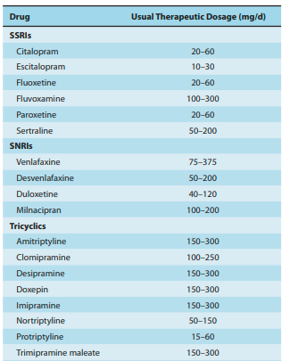
Antidepressant dose ranges.

Slide 92
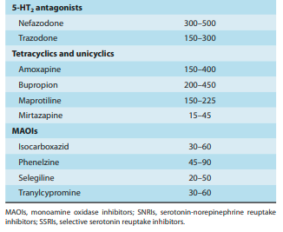

Slide 93
ADVERSE EFFECT
SELECTIVE SEROTONIN REUPTAKE INHIBITORS
The adverse effects of the most commonly prescribed antidepressants—the SSRIs—can be predicted from their potent inhibition of SERT.
SSRIs enhance serotonergic tone, not just in the brain but throughout the body.
Increased serotonergic activity in the gut is commonly associated with nausea, gastrointestinal upset, diarrhea, and other gastrointestinal symptoms.
Increasing serotonergic tone at the level of the spinal cord and above is associated with diminished sexual function and interest.

Slide 94
ADVERSE EFFECT
Other adverse effects related to the serotonergic effects of SSRIs include an increase in headaches and insomnia or hypersomnia
Some patients gain weight while taking SSRIs, particularly paroxetine.
Sudden discontinuation of short half-life SSRIs such as paroxetine and sertraline is associated with a discontinuation syndrome in some patients characterized by dizziness, paresthesias, and other symptoms beginning 1 or 2 days after stopping the drug and persisting for 1 week or longer.

Slide 95
ADVERSE EFFECT
SEROTONIN-NOREPINEPHRINE REUPTAKE INHIBITORS
SNRIs have many of the serotonergic adverse effects associated with SSRIs.
In addition, SNRIs may also have noradrenergic effects, including increased blood pressure and heart rate, and CNS activation, such as insomnia, anxiety, and agitation.
There are more reports of cardiac toxicity with venlafaxine overdose than with either the other SNRIs or SSRIs.
Duloxetine is rarely associated with hepatic toxicity in patients with a history of liver damage

Slide 96
ADVERSE EFFECT
TRICYCLIC ANTIDEPRESSANTS
Anticholinergic effects are perhaps the most common in TCA
These effects result in dry mouth, constipation, urinary retention, blurred vision, and confusion.
They are more common with tertiary amine TCAs such as amitriptyline and imipramine than with the secondary amine TCAs desipramine and nortriptyline.
The potent α-blocking property of TCAs often results in orthostatic hypotension.
H 1 antagonism by the TCAs is associated with weight gain and sedation.
Sexual effects are common, particularly with highly serotonergic TCAs such as clomipramine.
The TCAs have a prominent discontinuation syndrome characterized by cholinergic rebound and flulike symptoms.

Slide 97
ADVERSE EFFECT
5-HT 2 ANTAGONISTS
The most common adverse effects associated with the 5-HT 2 antagonists are sedation and gastrointestinal disturbances.
Sedative effects, particularly with trazodone, can be quite pronounced.
Both nefazodone and trazodone are α-blocking agents and may result in a dose-related orthostatic hypotension in some patients.
Nefazodone has been associated with hepatotoxicity, including rare fatalities and cases of fulminant hepatic failure requiring transplantation

Slide 98
ADVERSE EFFECT
TETRACYCLICS AND UNICYCLICS
Amoxapine is sometimes associated with a parkinsonian syndrome due to its D 2 -blocking action.
Mirtazapine has significant sedative effect.
Maprotiline has a moderately high affinity for NET and may cause TCA-like adverse effects and, rarely, seizures.
Bupropion is occasionally associated with agitation, insomnia, and anorexia.

Slide 99
ADVERSE EFFECT
MONOAMINE OXIDASE INHIBITORS
The most common adverse effects of the MAOIs leading to discontinuation of these drugs are orthostatic hypotension and weight gain.
In addition, the irreversible nonselective MAOIs are associated with the highest rates of sexual effects of all the antidepressants.
Anorgasmia is fairly common with therapeutic doses of some MAOIs.
The amphetamine-like properties of some MAOIs contributes to activation, insomnia, and restlessness in some patients.

Slide 100
ADVERSE EFFECT
Phenelzine tends to be more sedating than either selegiline or tranylcypromine.
Confusion is also sometimes associated with higher doses of MAOIs. because they block metabolism of tyramine and similar ingested amines, MAOIs may cause dangerous interactions with certain foods and with serotonergic drugs .
Finally, MAOIs have been associated with a sudden discontinuation syndrome manifested in a delirium-like presentation with psychosis, excitement, and confusion.

Slide 101
OVERDOSE
Overdose is the most common method used in suicide attempts, and antidepressants, especially the TCAs, are frequently involved.
Overdose can induce lethal arrhythmias, including ventricular tachycardia and fibrillation.
In addition, blood pressure changes and anticholinergic effects including altered mental status and seizures are sometimes seen in TCA overdoses.
Treatment typically involves cardiac monitoring, airway support, and gastric lavage.
Sodium bicarbonate is often administered to uncouple the TCA from cardiac sodium channels.

Slide 102
OVERDOSE
An overdose with an MAOI can produce a variety of effects including autonomic instability, hyperadrenergic symptoms, psychotic symptoms, confusion, delirium, fever, and seizures.
Management of MAOI overdoses usually involves cardiac monitoring, vital signs support, and lavage.
Compared with TCAs and MAOIs, the other antidepressants are generally much safer in overdose.
Fatalities with SSRI overdose alone are extremely uncommon.
Similarly, SNRIs tend to be much safer in overdose than the TCAs

Slide 103
OVERDOSE
However, venlafaxine has been associated with some cardiac toxicity in overdose and appears to be less safe than SSRIs.
Bupropion is associated with seizures in overdose, and mirtazapine may be associated with sedation, disorientation, and tachycardia.
With the newer agents, fatal overdoses often involve the combination of the antidepressant with other drugs, including alcohol.
Management of overdose with the newer antidepressants usually involves emptying of gastric contents and vital sign support as the initial intervention.

Slide 104
DRUG INTERACTIONS
Antidepressants are commonly prescribed with other psychotropic and nonpsychotropic agents. There is potential for drug interactions with all antidepressants.
The most serious of these involve the MAOIs and to a lesser extent the TCAs.
SELECTIVE SEROTONIN REUPTAKE INHIBITORS
The most common interactions with SSRIs are pharmacokinetic interactions.
For example, paroxetine and fluoxetine are potent CYP2D6 inhibitors
Administration with 2D6 substrates such as TCAs can lead to dramatic

Slide 105
DRUG INTERACTIONS
Sometimes unpredictable elevations in the tricyclic drug concentration.
The result may be toxicity from the TCA.
Similarly, fluvoxamine, a CYP3A4 inhibitor, may elevate the levels of concurrently administered substrates for this enzyme such as diltiazem and induce bradycardia or hypotension.
Other SSRIs, such as citalopram and escitalopram, are relatively free of pharmacokinetic interactions.
The most serious interaction with the SSRIs are pharmacodynamic interactions with MAOIs that produce a serotonin syndrome

Slide 106
DRUG INTERACTIONS
SELECTIVE SEROTONIN-NOREPINEPHRINE REUPTAKE INHIBITORS
The SNRIs have relatively fewer CYP450 interactions than the SSRIs.
Venlafaxine is a substrate but not an inhibitor of CYP2D6 or other isoenzymes
Desvenlafaxine is a minor substrate for CYP3A4.
Duloxetine is a moderate inhibitor of CYP2D6 and so may elevate TCA and levels of other CYP2D6 substrates.
Like all serotonergic antidepressants, SNRIs are contraindicated in combination with MAOIs.

Slide 107
DRUG INTERACTIONS
Tricyclic Antidepressants
Elevations of TCA levels may occur when combined with CYP2D6 inhibitors or from constitutional factors.
About 7% of the Caucasian population in the USA has a CYP2D6 polymorphism that is associated with slow metabolism of TCAs and other 2D6 substrates.
Combination of a known CYP2D6 inhibitor and a TCA in a patient who is a slow metabolizer may result in additive effects.
There may also be additive TCA effects such as anticholinergic or antihistamine effects when combined with other agents that share these properties such as benztropine or diphenhydramine.

Slide 108
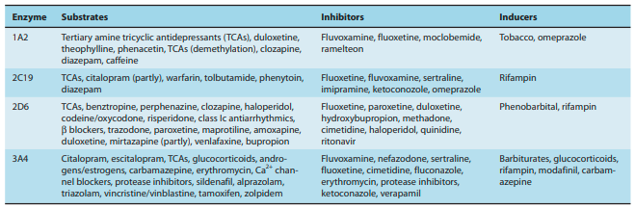
Some antidepressant–CYP450 drug interactions

Slide 109
DRUG INTERACTIONS
Similarly, antihypertensive drugs may exacerbate the orthostatic hypotension induced by TCAs.
5-HT 2 ANTAGONISTS
Nefazodone is an inhibitor of the CYP3A4 isoenzyme, so it can raise the level and thus exacerbate adverse effects of many 3A4- dependent drugs.
For example, triazolam levels are increased by concurrent administration of nefazodone such that a reduction in triazolam dosage by 75% is recommended.
Likewise, administration of nefazodone with simvastatin has been associated with 20-fold increase in plasma levels of simvastatin.
.

Slide 110
DRUG INTERACTIONS
Trazodone is a substrate but not a potent inhibitor of CYP3A4
As a result, combining trazodone with potent inhibitors of CYP3A4, such as ritonavir or ketoconazole, may lead to substantial increases in trazodone level
TETRACYCLIC AND UNICYCLIC ANTIDEPRESSANTS
Bupropion is metabolized primarily by CYP2B6, and its metabolism may be altered by drugs such as cyclophosphamide, which is a substrate of 2B6.
The major metabolite of bupropion, hydroxybupropion, is a moderate inhibitor of CYP2D6 and so can raise desipramine levels.
Bupropion should be avoided in patients taking MAOIs.

Slide 111
DRUG INTERACTIONS
Mirtazapine is a substrate for several CYP450 enzymes including 2D6, 3A4, and 1A2.
Consequently, drugs that inhibit these isozymes may raise mirtazapine levels.
Amoxapine and maprotiline share most drug interactions common to the TCA group.
Both are CYP2D6 substrates and should be used with caution in combination with inhibitors such as fluoxetine.
Amoxapine and maprotiline also both have anticholinergic and antihistaminic properties that may be additive with drugs that share a similar profile

Slide 112
DRUG INTERACTIONS
MONOAMINE OXIDASE INHIBITORS
MAOIs are associated with two classes of serious drug interactions. The first of these is the pharmacodynamic interaction of MAOIs with serotonergic agents including SSRIs, SNRIs, and most TCAs along with some analgesic agents such as meperidine.
These combinations of an MAOI with a serotonergic agent may result in a life-threatening serotonin syndrome.
The serotonin syndrome is thought to be caused by overstimulation of 5-HT receptors in the central gray nuclei and the medulla

Slide 113
DRUG INTERACTIONS
Symptoms range from mild to lethal and include a triad of cognitive (delirium, coma), autonomic (hypertension, tachycardia, diaphoreses), and somatic (myoclonus, hyperreflexia, tremor) effects.
Most serotonergic antidepressants should be discontinued at least 2 weeks before starting an MAOI.
Fluoxetine, because of its long half-life, should be discontinued for 4–5 weeks before an MAOI is initiated.
Conversely, an MAOI must be discontinued for at least 2 weeks before starting a serotonergic agent

Slide 114
DRUG INTERACTIONS
The second serious interaction with MAOIs occurs when an MAOI is combined with tyramine in the diet or with sympathomimetic substrates of MAO.
An MAOI prevents the breakdown of tyramine in the gut, and this results in high serum levels that enhance peripheral noradrenergic effects, including raising blood pressure dramatically.
Patients on an MAOI who ingest large amounts of dietary tyramine may experience malignant hypertension and subsequently a stroke or myocardial infarction
Thus, patients taking MAOIs require a low-tyramine diet and should avoid foods such as aged cheeses, tap beer, soy products, and dried sausages, which contain high amounts of tyramine

Slide 115
DRUG INTERACTIONS
Similar sympathomimetics also may cause significant hypertension when combined with MAOIs.
Thus, over-the-counter cold preparations that contain pseudoephedrine and phenylpropanolamine are contraindicated in patients taking MAOIs.

Slide 116
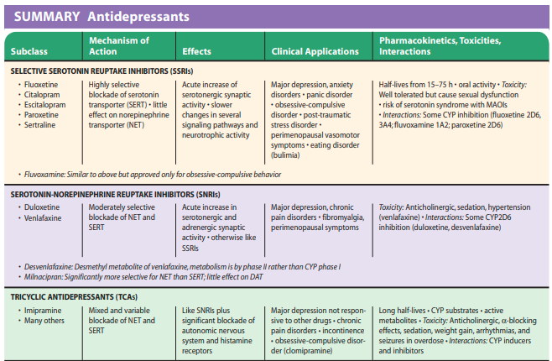

Slide 117
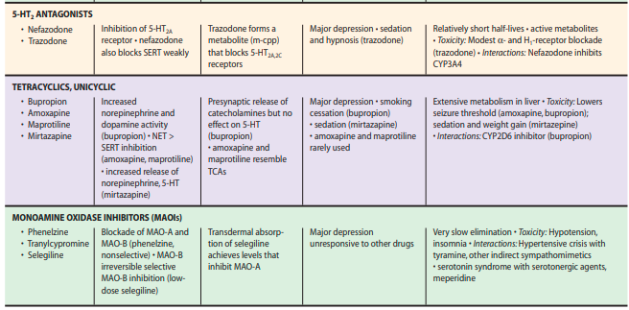

Slide 118
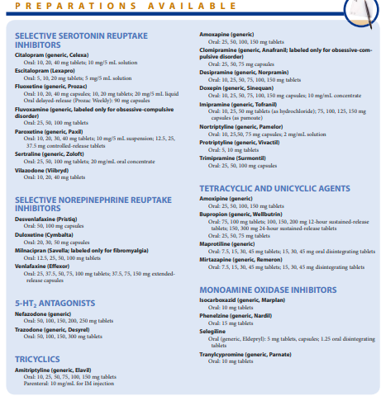

Slide 119
֍THANK YOU֍

